Slide 1
“The science of exercise and the art of coaching”

Slide 2
Outline for talk
Brief review of energy systems
Determinants of endurance performance
Muscle fiber type and recruitment
Energy systems part II: what they didn’t teach you in Ex. Phys. 101
5. Application to interval training

Slide 3
Adenosine triphosphate (ATP): the “energy currency” of cells
ATP ADP + P_{i}

Slide 4
Resynthesis of ATP: three energy systems
Phosphagen system:
    PCr + ADP Cr + ATP
    ADP + ADP ATP + AMP
Non-aerobic glycolysis:
    glucose 2 lactate + 2H⁺ + 2ATP
Aerobic metabolism:
    glucose + 6O₂ 6CO₂ + 6H₂0 + 36ATP
    palmitic acid + 23O₂ 16CO₂ + 16H₂0 + 130ATP

Slide 5
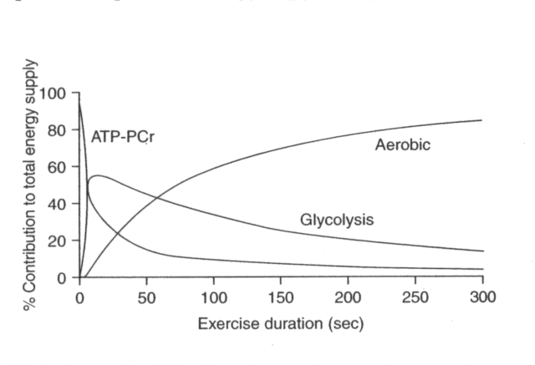
Three energy systems: relative contributions
From: Gastin PB. Energy system interaction and relative contribution during maximal exercise. Sports Med 31:725, 2001

Slide 6
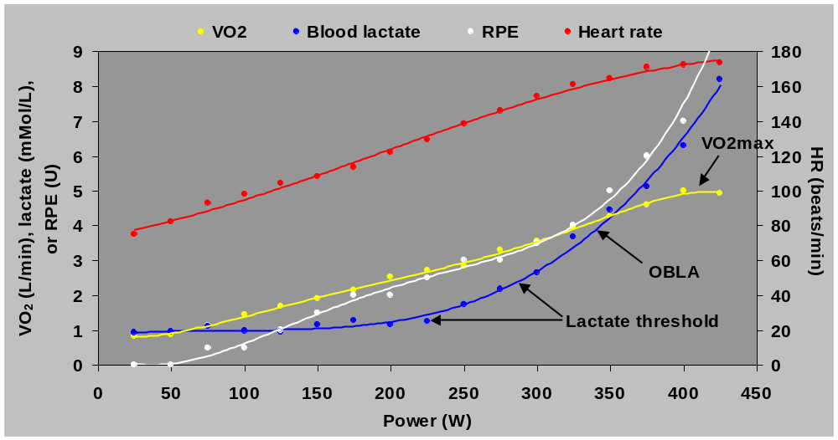
VO₂, heart rate, lactate, and RPE vs. power

Slide 7
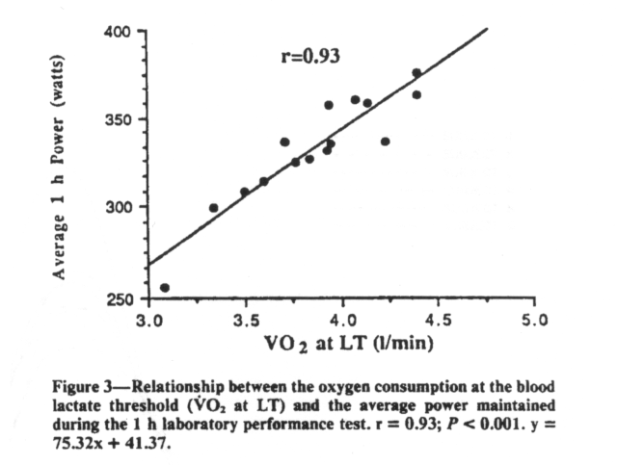
Importance of LT
From: Coyle EF et al. Physiological and biomechanical factors associated with elite endurance cycling performance. MSSE 23:93, 1991.

Slide 8
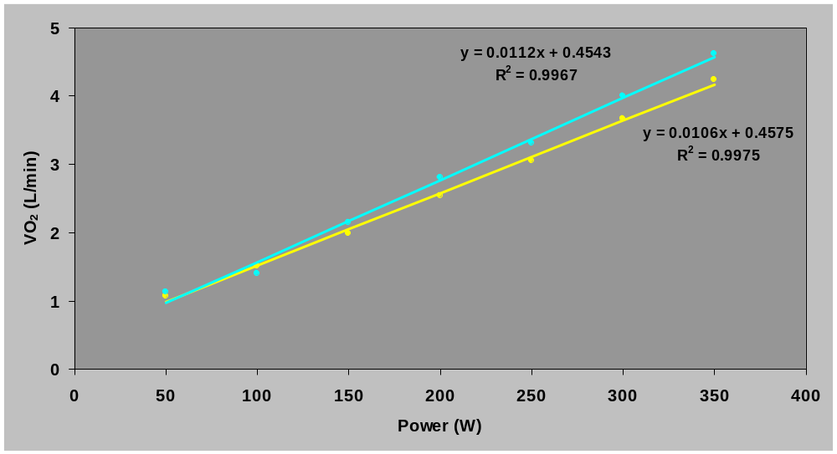
VO₂ vs. power (economy/efficiency)

Slide 9
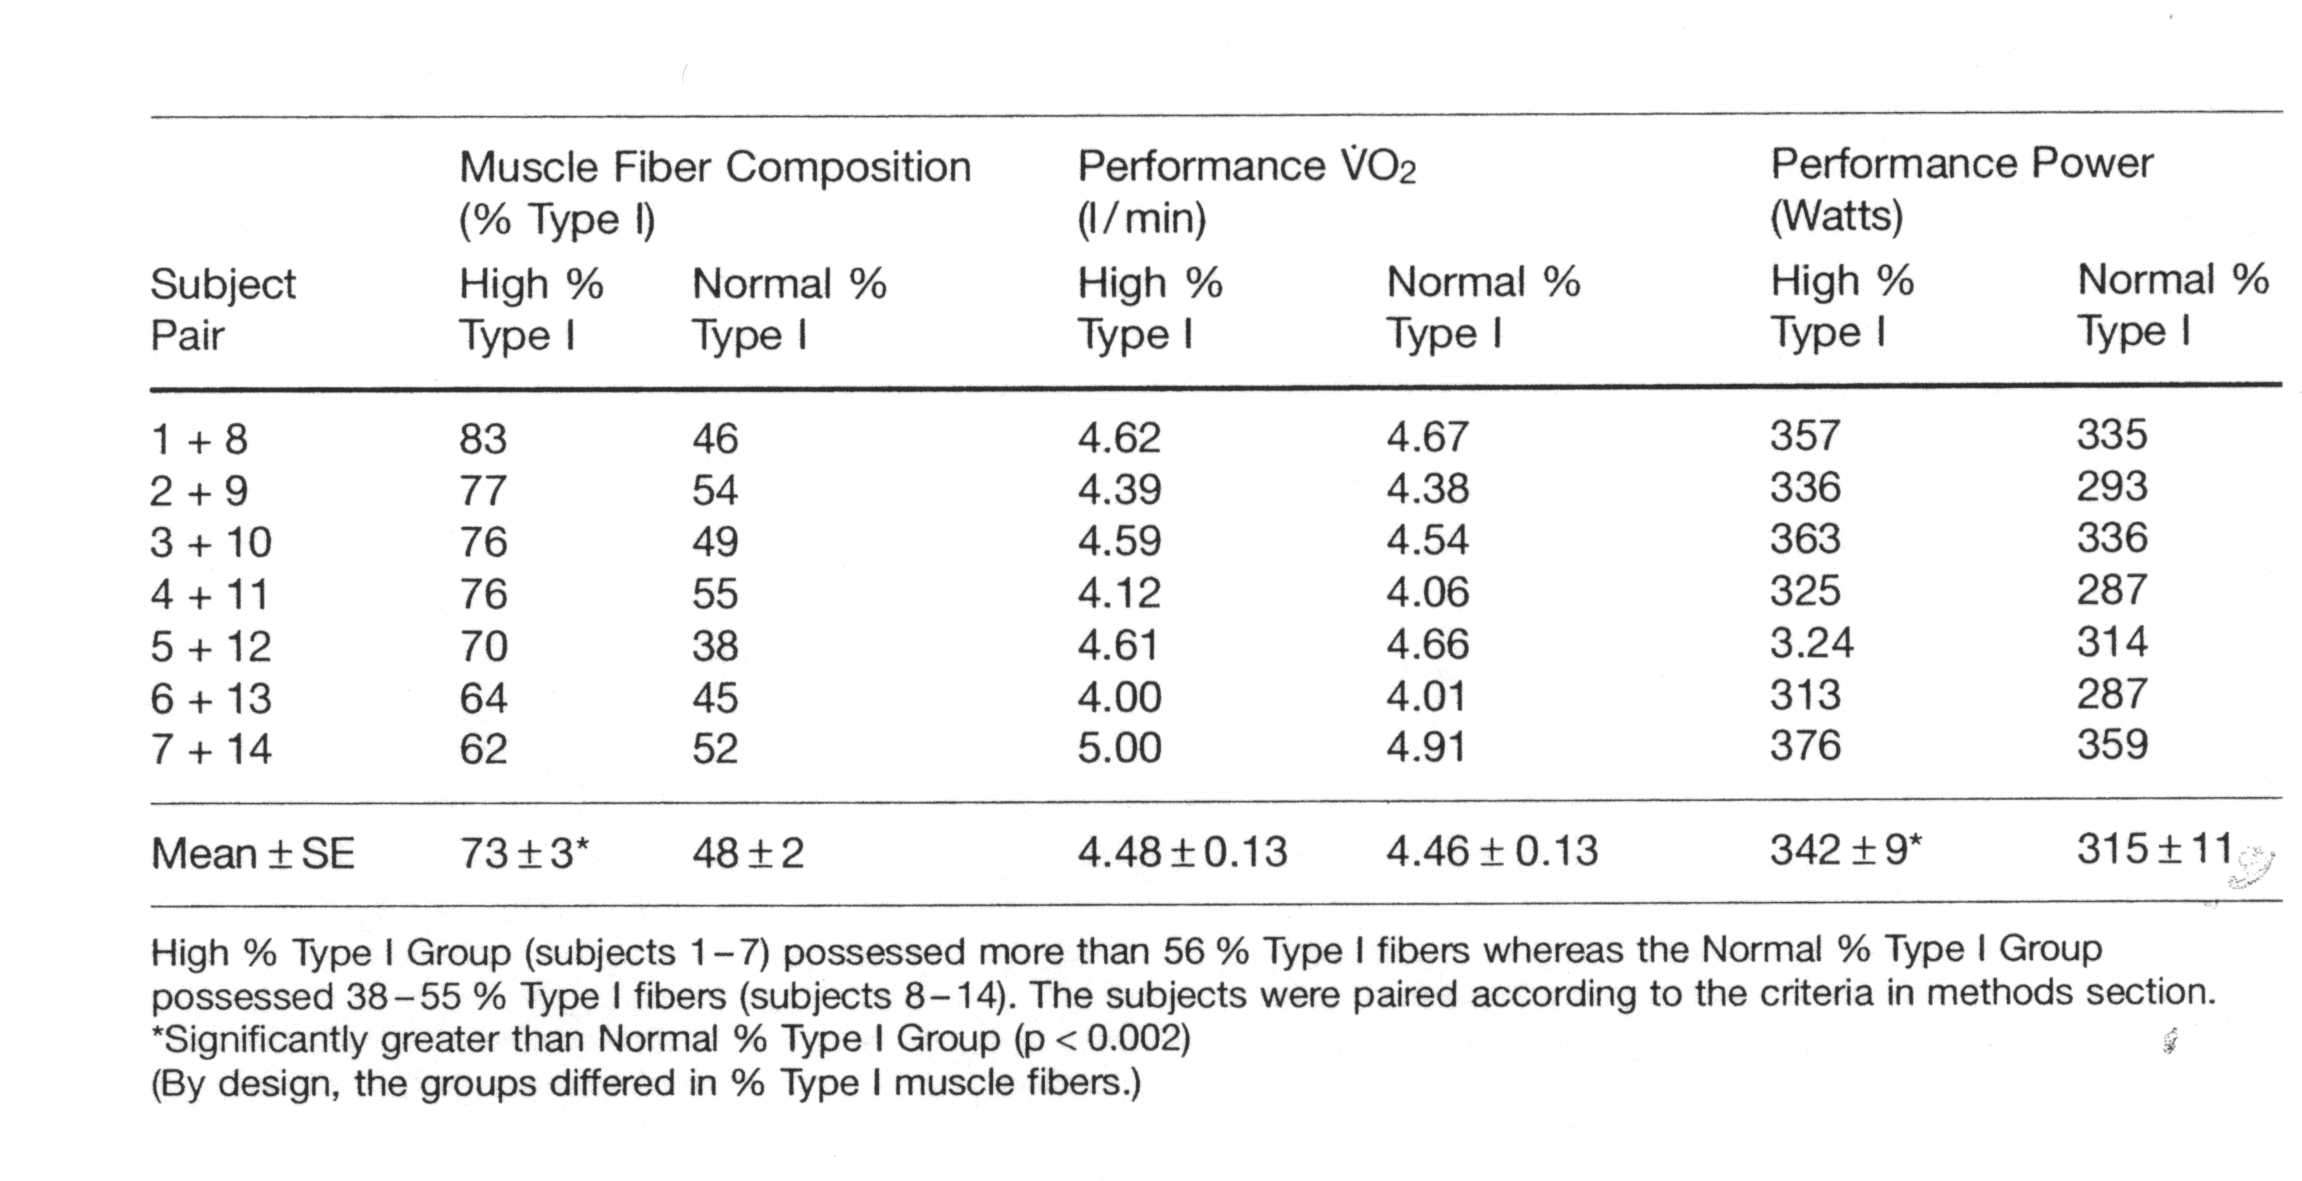
Effect of efficiency on performance
From: Horowitz JF, Sidossis LS, Coyle EF. High efficiency of type I fibers improves performance. Int. J. Sports Med. 15:152, 1994.

Slide 10
Human skeletal muscle fiber type characteristics
 | Type I | Type IIa | Type IIb(x)
Size of muscle fiber | Smallest | Larger | Largest
# of fibers in motor unit | Smallest | Larger | Largest
Size of alpha motor neuron | Smallest | Larger | Largest
Order of recruitment | First | Next | Last
Force at zero velocity (per unit area) | Same | Same | Same
Speed of contraction | Slowest | Faster | Fastest
Force/power at velocity greater than zero | Lowest | Higher | Highest
PCr content | Lowest | Higher | Highest
Glycolytic enzyme activities | Lowest | Higher | Highest
Glycogen content | Lowest | Higher | Highest
Triglyceride content | Highest | Lower | Lowest
Mitochondrial enzyme activities | Highest | Lower | Lowest
Capillarization | Highest | Lower | Lowest
Fatigue resistance | Highest | Lower | Lowest

Slide 11
Factors affecting fiber type recruitment
Exercise intensity
Exercise duration
Cadence?

Slide 12
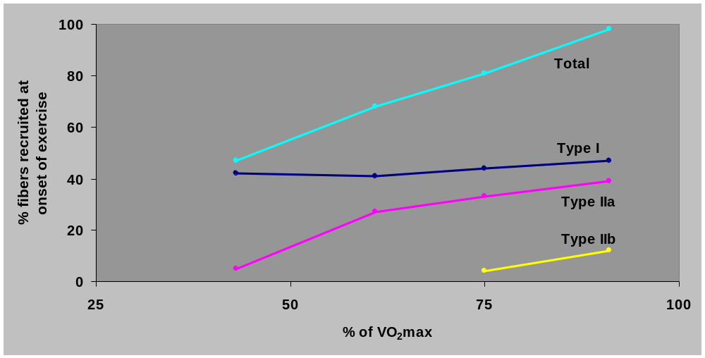
Fiber type recruitment as a function of intensity
From: Vollestad NK et al. Effect of varying exercise intensity on glycogen depletion in human muscle fibers. Acta Physiol Scand 125:395, 1985.

Slide 13
Energy systems part II:
What they didn’t teach you in Exercise Physiology 101

Slide 14
Three energy systems: relative contributions
From: Gastin PB. Energy system interaction and relative contribution during maximal exercise. Sports Med 31:725, 2001

Slide 15
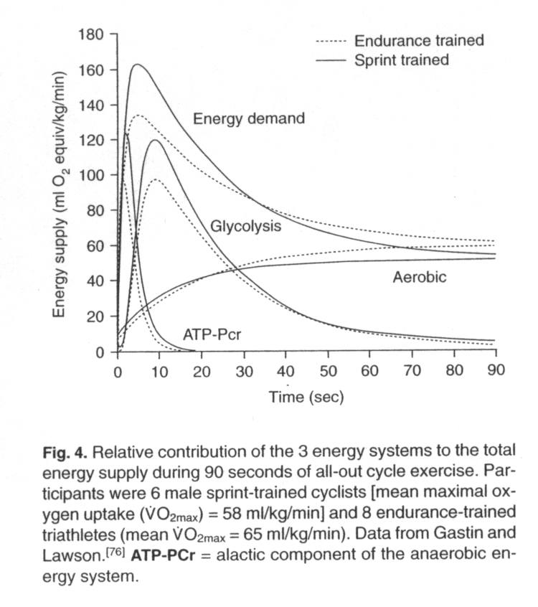
Three energy systems: absolute contributions
From: Gastin PB. Energy system interaction and relative contribution during maximal exercise. Sports Med 31:725, 2001

Slide 16
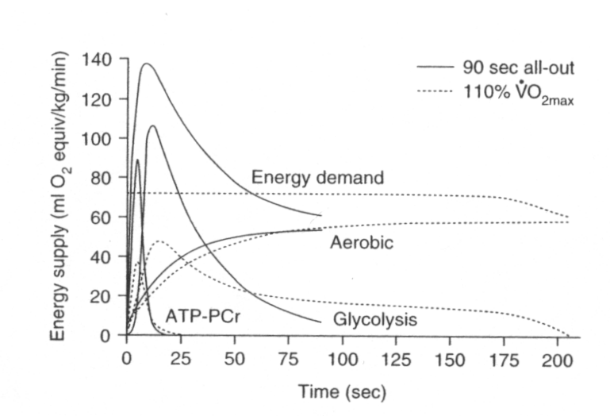
Three energy systems: all-out vs. constant intensity
From: Gastin PB. Energy system interaction and relative contribution during maximal exercise. Sports Med 31:725, 2001

Slide 17
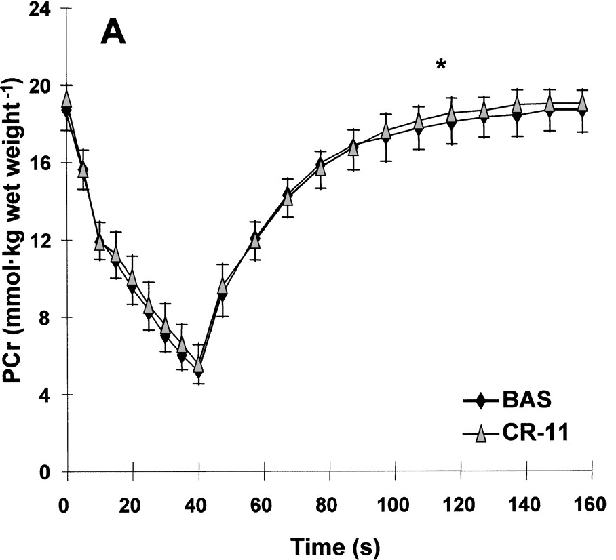
Half-time of PCr resynthesis

Slide 18
Half-lives of physiological responses
Power (force and/or velocity) (0 s)
Heart rate/cardiac output: ~25 s
Sweating: ~25 s
VO₂: ~30 s
VCO₂: ~45 s
Ventilation: ~50 s
Temperature (core): ~70 s

Slide 19
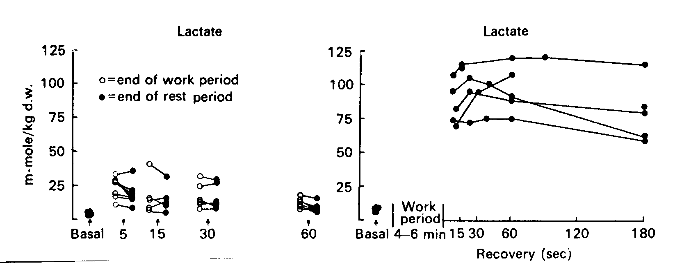
Metabolic response to “micro” intervals

Slide 20
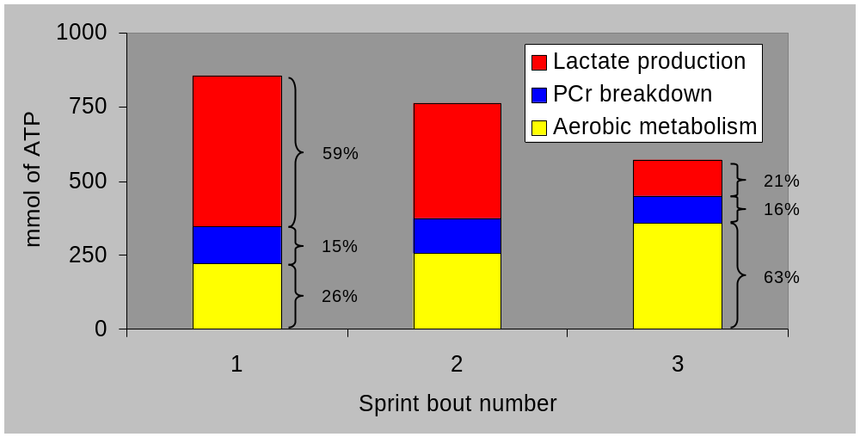
Energy metabolism during 30 s sprints
From: Putman CT et al. Skeletal muscle pyruvate dehydrogenase activity during maximal exercise in humans. Am J Physiol 269:E458, 1995.

Slide 21
Analysis of different interval training sessions
LT intervals: 2 x 20:00/5:00
VO₂max intervals: 6 x 5:00/2:30
LT intervals: 8 x 5:00/1:00
Anaerobic capacity intervals: 10 x 1:00/3:00

Slide 22
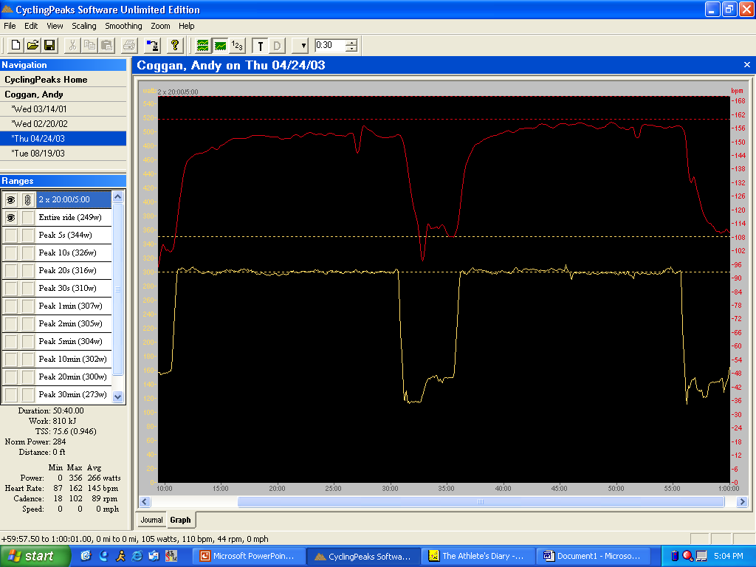
LT intervals: 2 x 20:00/5:00

Slide 23
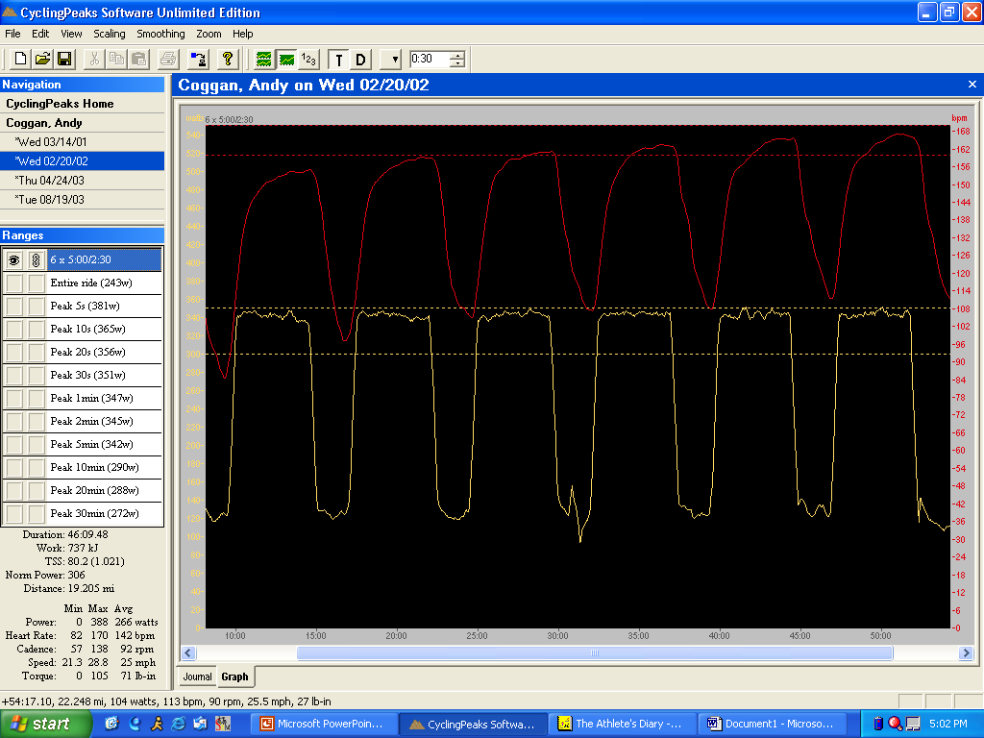
VO₂max intervals: 6 x 5:00/2:30

Slide 24

LT intervals: 8 x 5:00/1:00

Slide 25
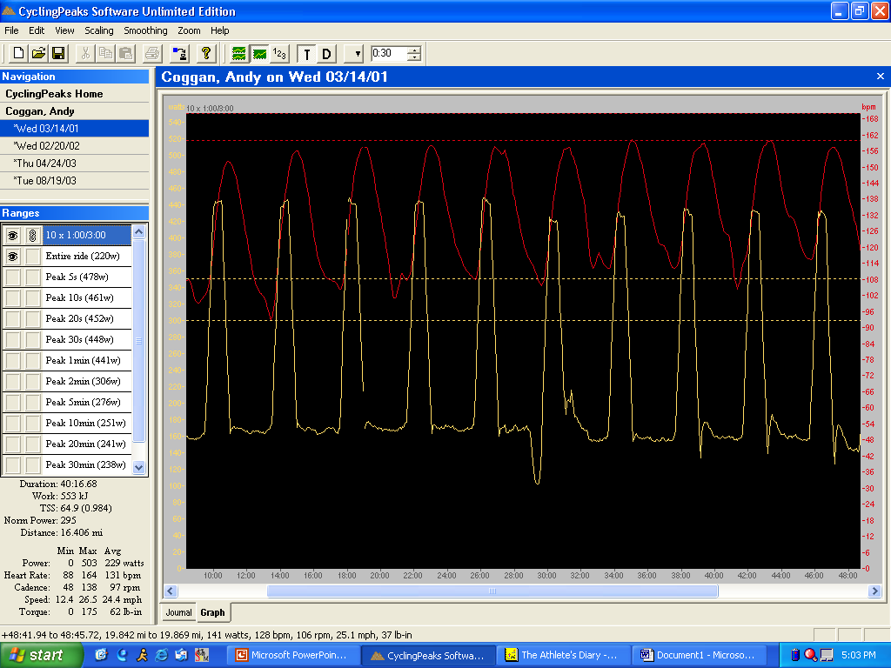
Anaerobic capacity intervals: 10 x 1:00/3:00

